Slide 1





To increase the Win Ratio of the player using the player’s PUBG stats

Slide 2
Objective
Win ratio Analysis for each game type (Solo, Duo and Squad) using:
Players kill death ratio.
Average time survived in the game.
Number of round played by the player.
The data used to determine the win ratio is selected based on the correlation between the stats.
Using the above data, I have analyzed and provided a solution on how to increase the players win ratio keeping in mind the number of games played, average time survived, and the players kill death ratio.

Slide 3
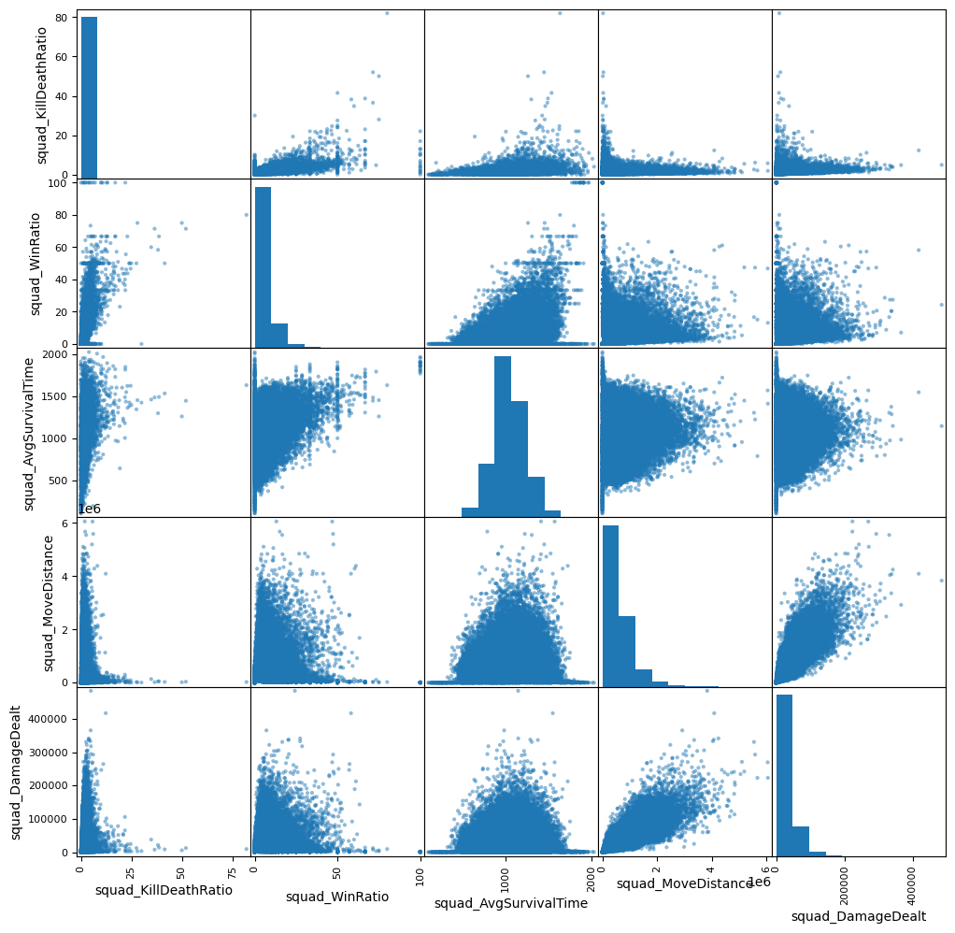
Checking the correlation between the stats in the data set.
By using the scatter plot matrix, I have selected the stats which have high correlation with the players win ratio.

Slide 4
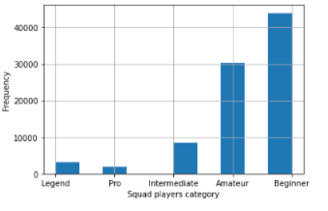
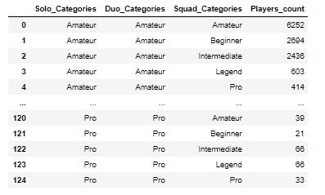
Determine the players level in the game
Before going into providing the solution I tried to rate the players based on the win ratio.
Based on my analysis I have categorized the players into different categories as mentioned below.
Beginner
Amateur
Intermediate
Pro
Legend

Slide 5
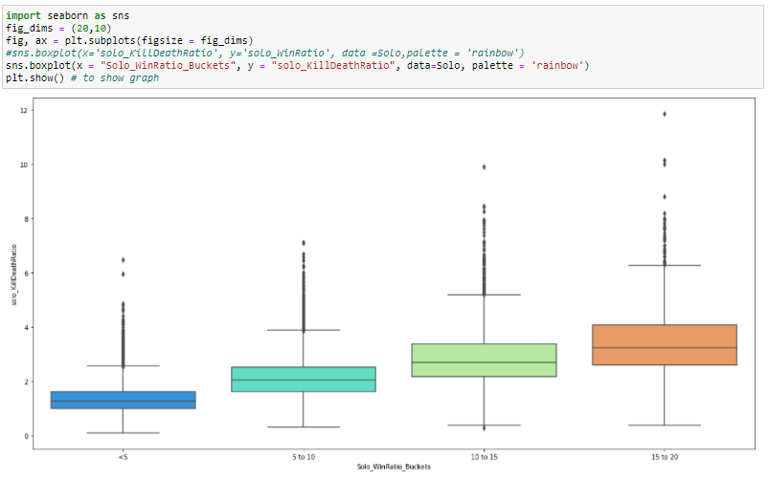
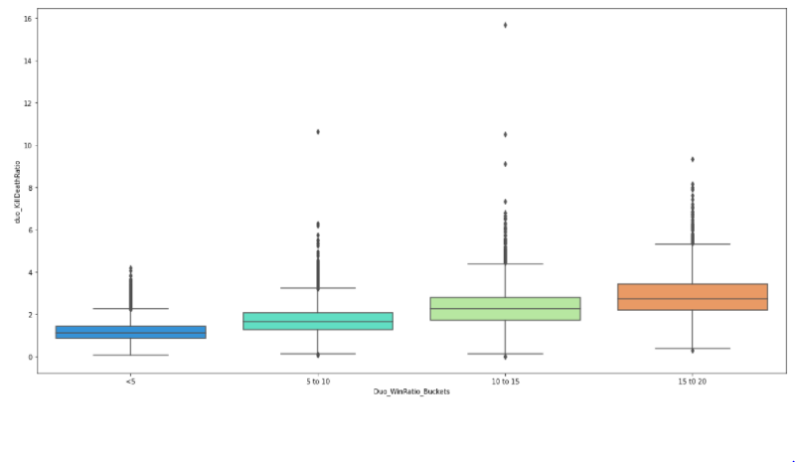
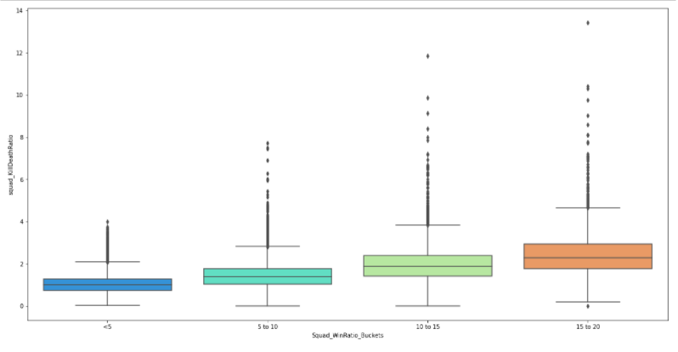
Win ratio analysis using the kill death ratio
So, by comparing these two columns of data, I am trying to see whether the win ratio of a player increase when the player has more kill death ratio.

Slide 6
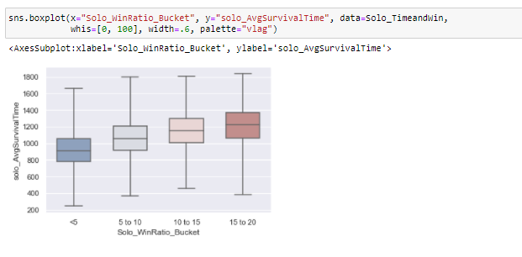
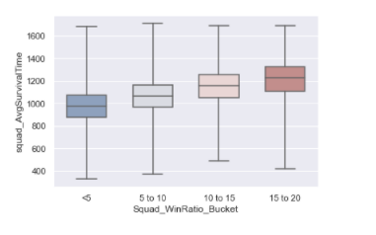
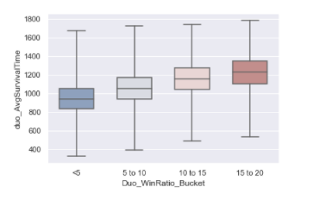
Win ratio analysis using the average time survival
Average survival time of a player is the average of the time which player survived in each game which they have played. So, using this data I am trying to determine whether the players who survived more time in the game have the possibility of winning the games and increasing their win ratio.

Slide 7
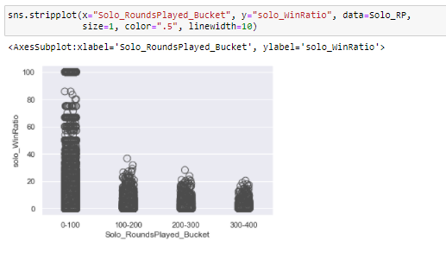
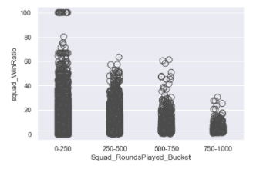
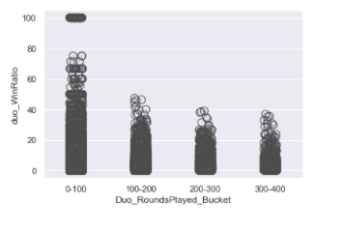
Win ratio analysis using the Number of the round played
I have taken rounds played to determine whether the win ratio varies based on the number of games played. This was based on my experience when playing the game. As the level of player increases the number of games, he played come into factor more than we expect. The players who have played more games have more experience, but will this help them increase their win ratio?

Slide 8
Conclusion
The above analysis was giving the results as expected. So, to answer my question more efficiently. I Compared the Win Ratio with the round played to check whether the Players win ratio increases when he/she plays more game. This analysis led to an interesting result, result was different compared to previous analysis because as the player plays more and more game the win ratio of the player is decreasing. Which I found as an interesting finding.

